Slide 1

D&D Group Finder
By: Matthew Berwick & Arodi Kapuadi

Slide 2
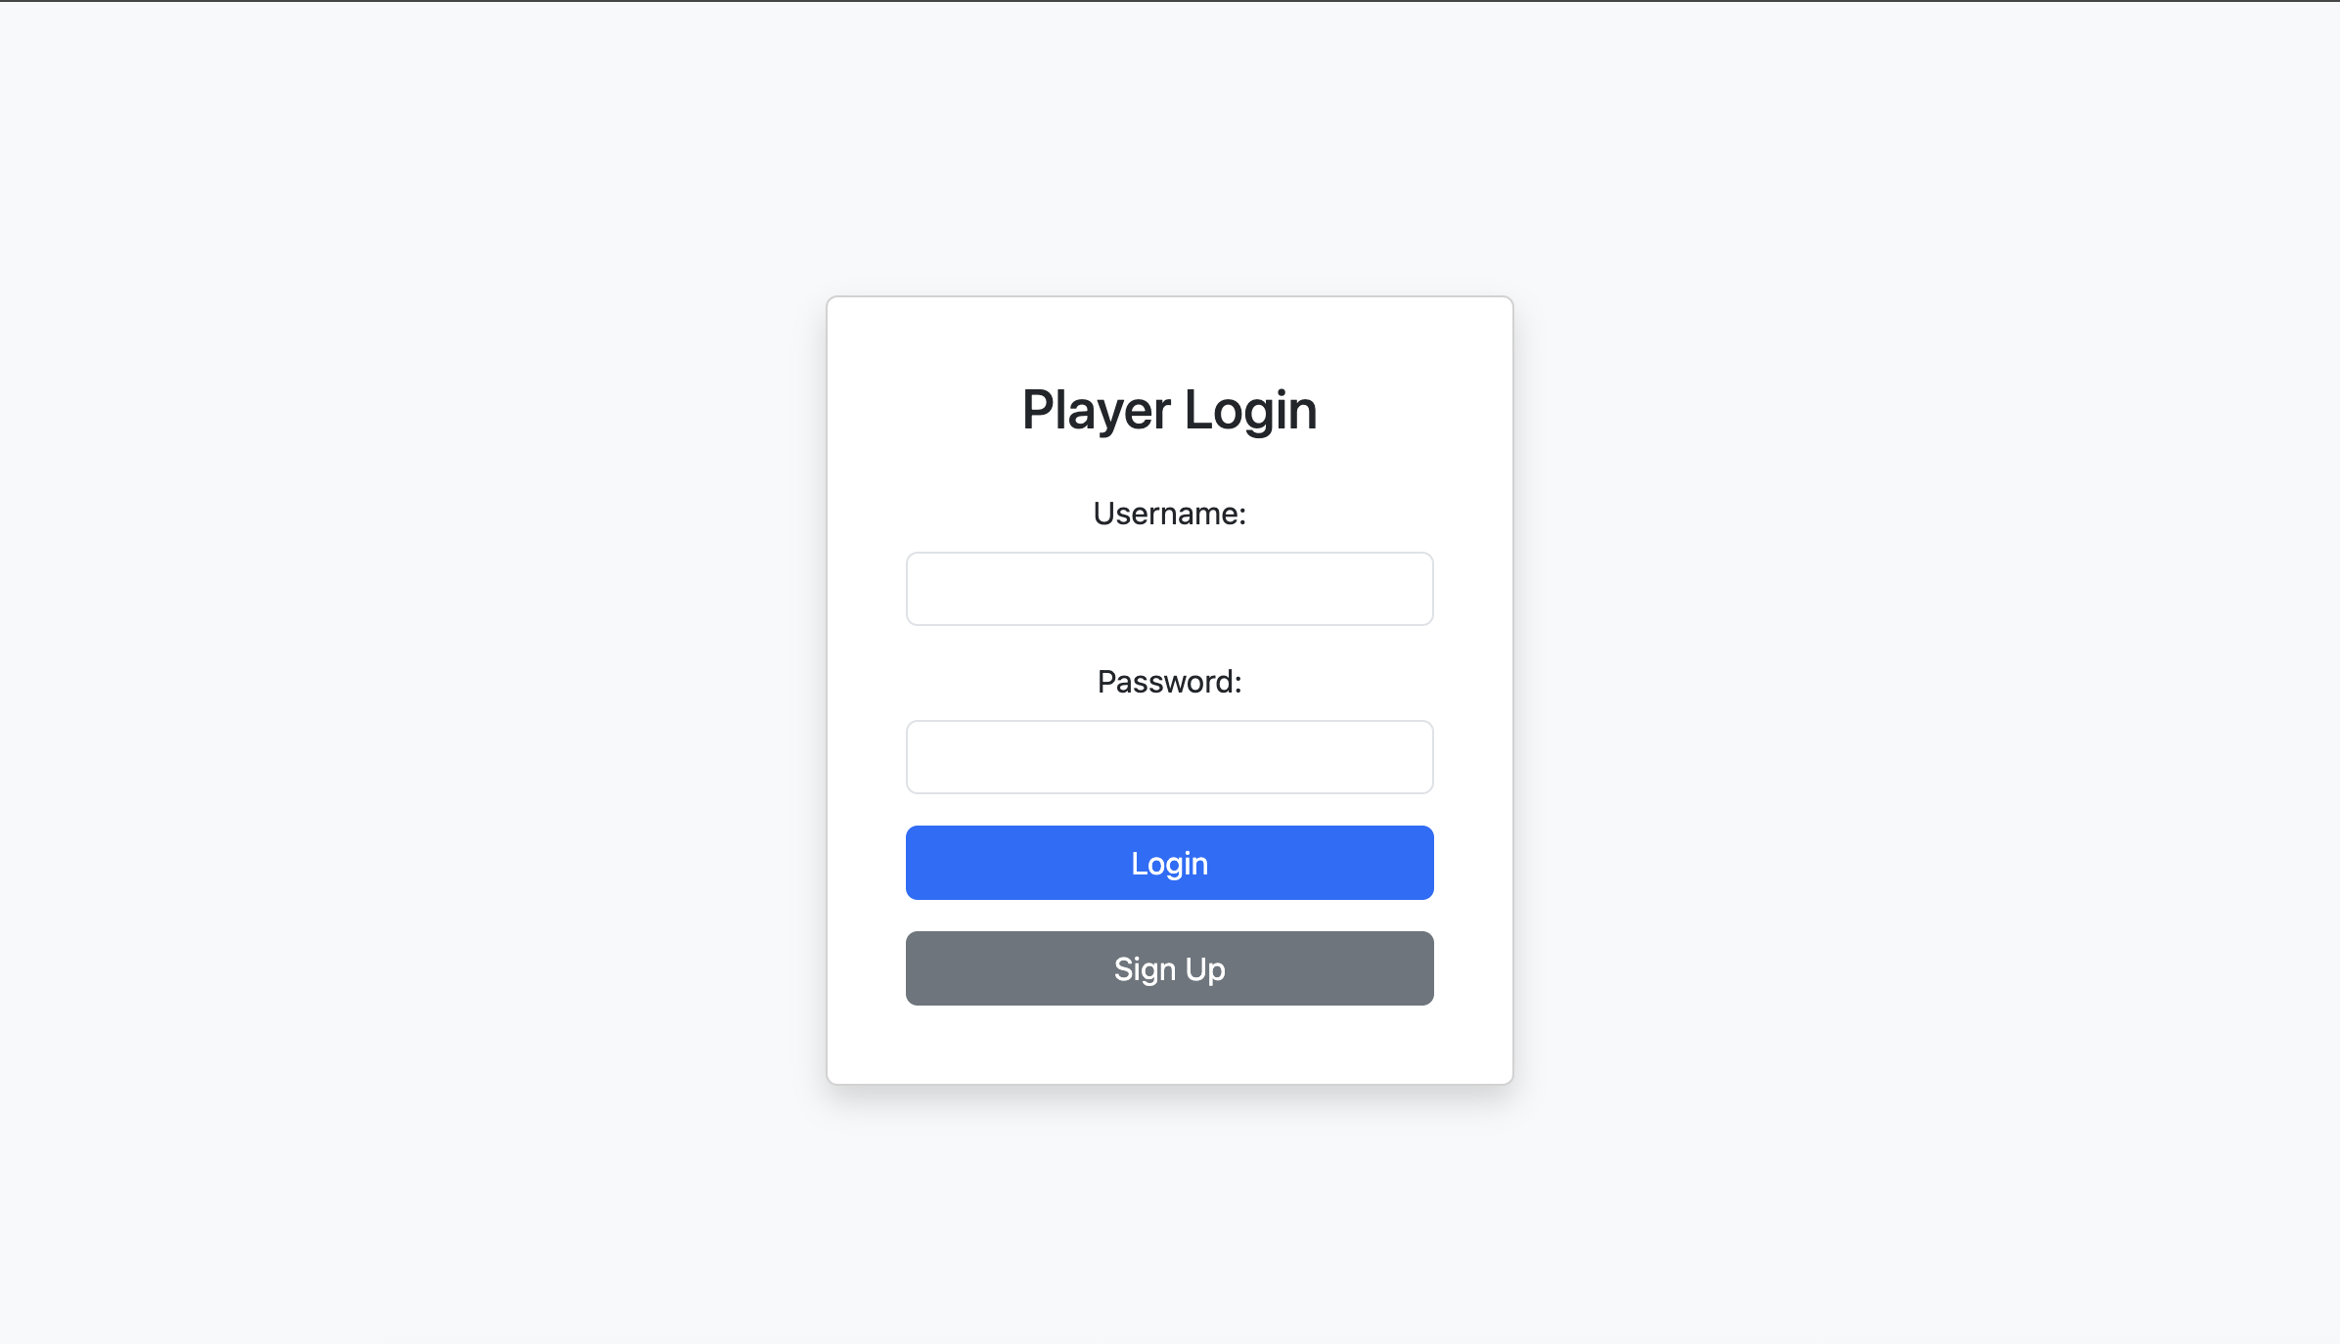
Player Login
The Player Login page allows registered players to securely access their account. The design is clean and centered for better usability, using Bootstrap for consistent styling. Users are prompted to enter their username and password. There’s also a sign-up button that redirects new users to the Player Sign Up page. Although the current version doesn’t have backend functionality, it simulates the login process by navigating to the homepage upon form submission. This page is a vital entry point for players to access features such as finding game groups or leaving reviews.

Slide 3
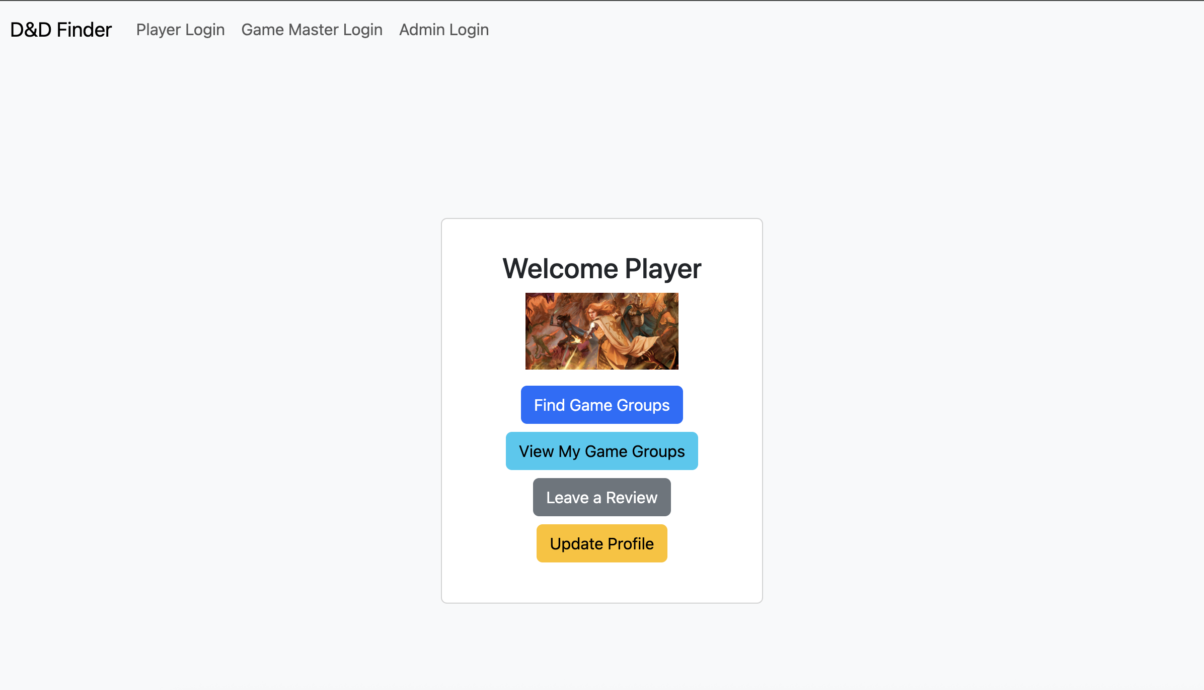
Player Homepage
The Player Homepage serves as the central hub after login, welcoming the user and presenting navigation buttons to access different features. These include “Find Game Groups,” “Leave a Review,” “Update Profile,” and “View Game Groups.” Each button leads to a corresponding placeholder page, laying the structure for future functionality. The layout uses a card format with an optional avatar image for personalization. This page is designed to be simple, clear, and functional, helping players easily find and interact with the key parts of the D&D Finder system.

Slide 4
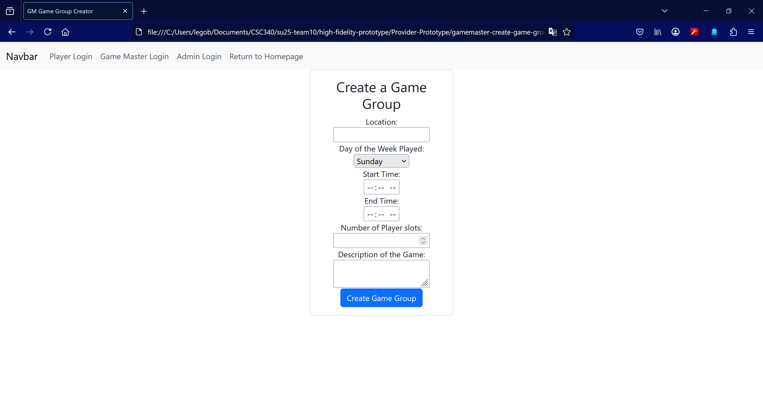
Game Master Creating a Game Group
On this page, a game master user can create a game group, which would be added to a database of all game group.
They will need to enter all the information, which includes the location, the day of the week the game will be played, start/end time, number of player slots, and the description.

Slide 5
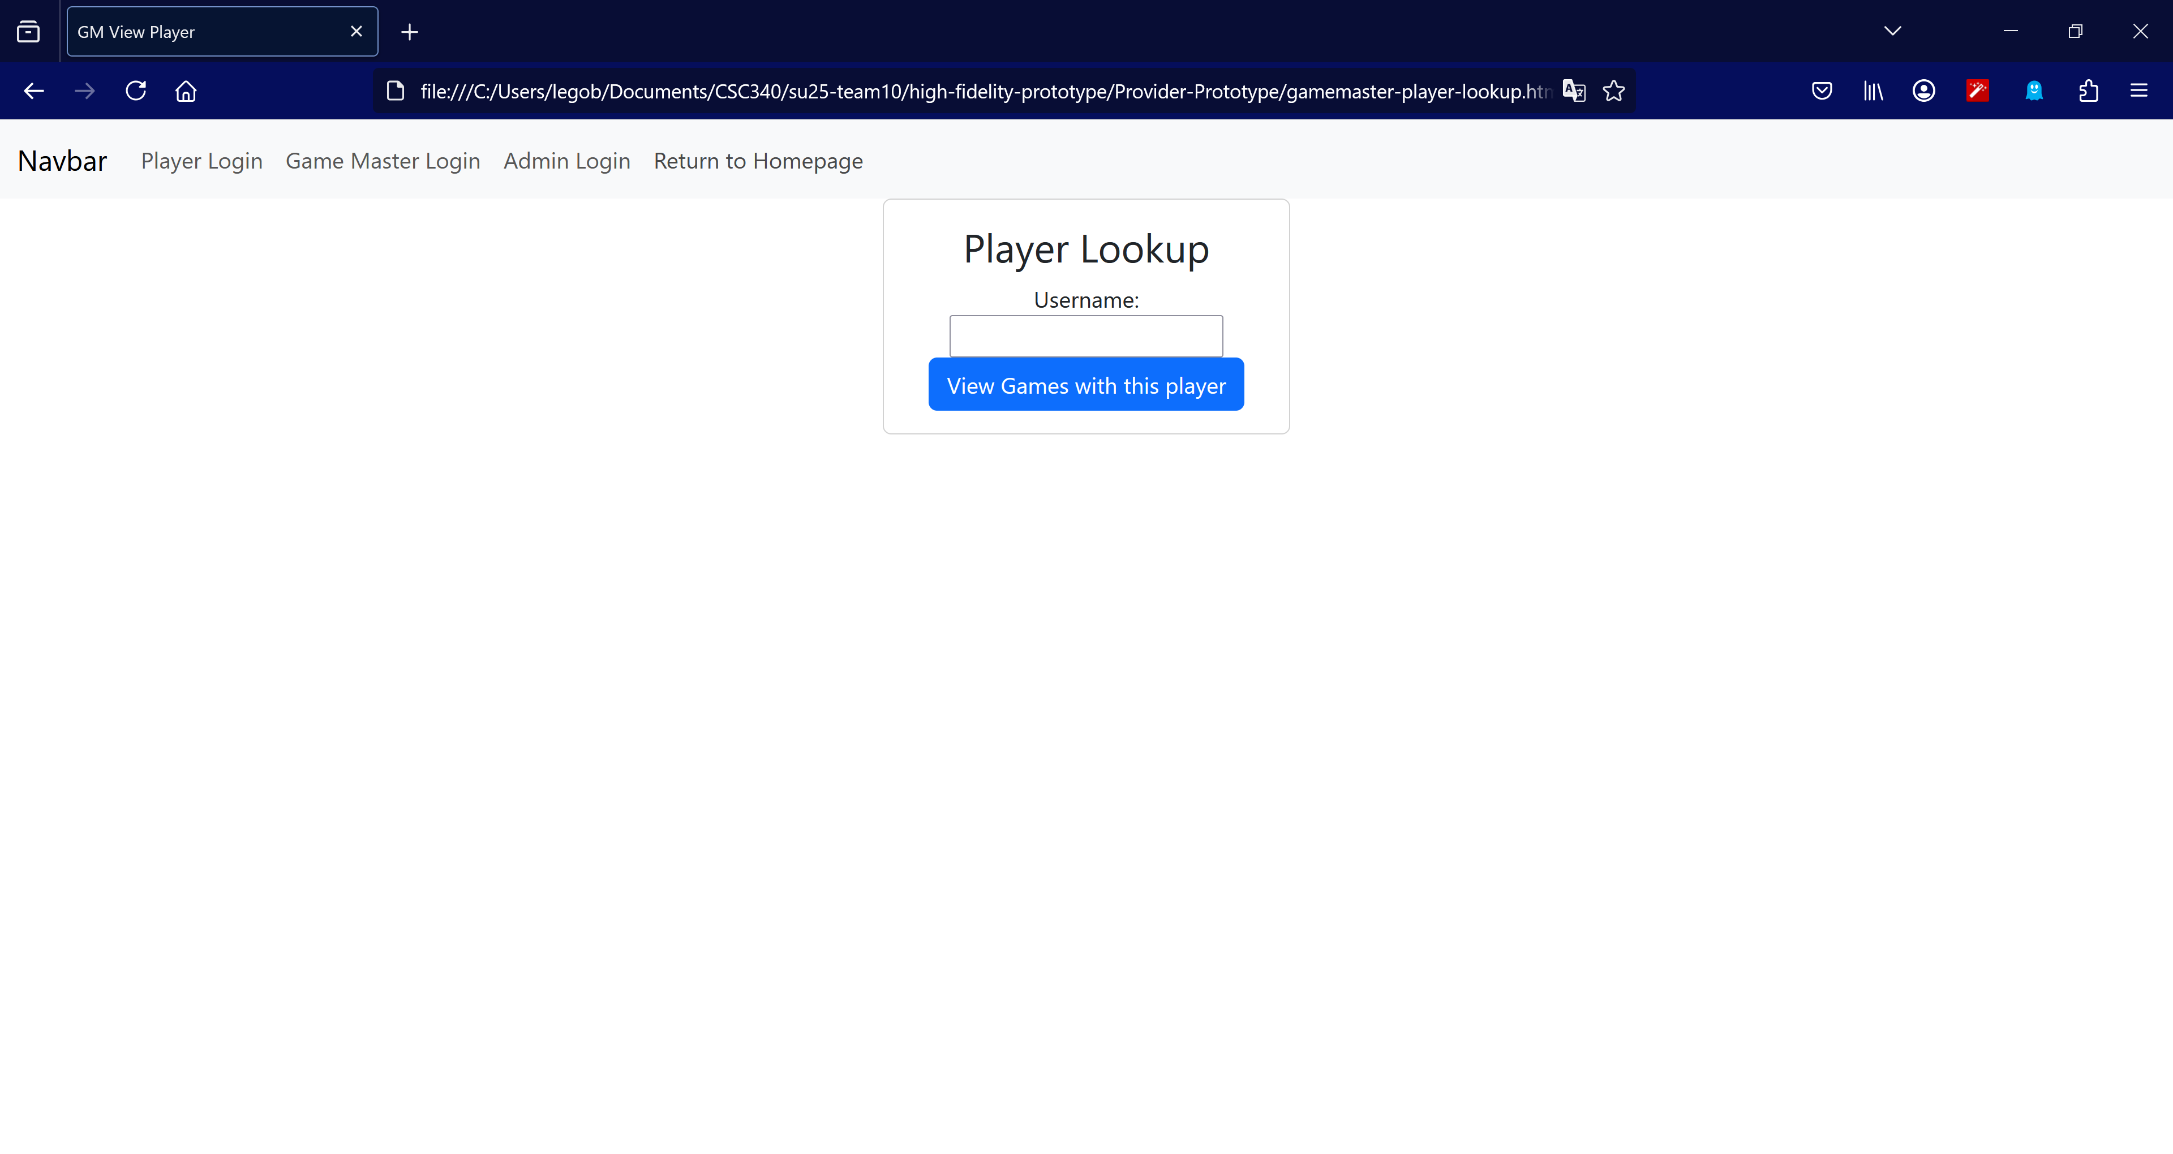
Game Master Viewing the Game Groups of a Player
This page allows a Game Master user to view all game groups of a specific Player user.
This will display all the relevant data about each game group.
This would allow them to see if there are any schedule conflicts with said Player user, either from time or location.

